Slide 1


Data Structures
Lab # 3 Memory Management

Slide 2

Memory Management
C/C++ Programs are provided with different memory areas
Stack→ Local Variables
Data Section → Static and Global Variables
Heap → Allocated at Runtime.
All the memory is taken from the process address space.
C++ supports dynamic memory allocation.
Allocation on the heap is managed by programmer.

Slide 3
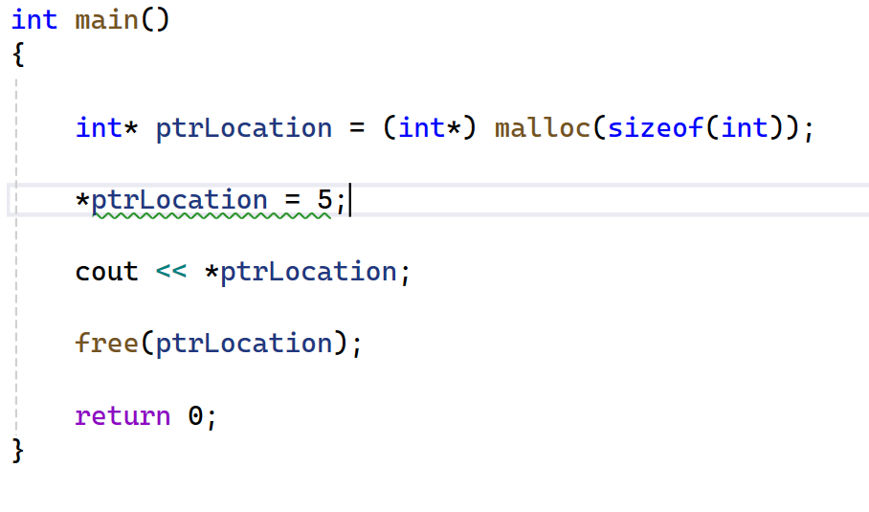
malloc()
malloc is a C library function that allocates a raw block of memory of a given size on the heap and returns a void* pointer to it.
It just reserves a raw block of bytes in the heap and returns a pointer to the start of that block.
We use malloc when we want manual control over memory and when the memory requirements are decided at runtime.
malloc(size) → Return the memory chunk, and void pointer that point start of it.

Slide 4
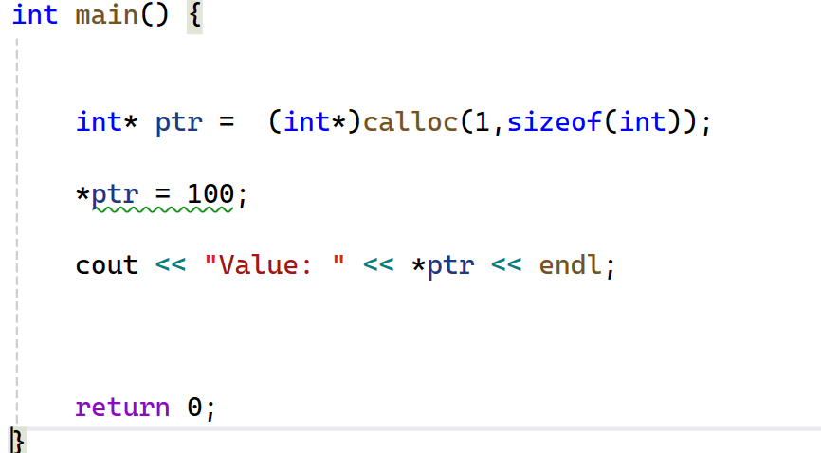
calloc()
We use calloc() to dynamically allocate contiguous memory for multiple elements and automatically initialize them to zero.
Slightly slower then malloc.
calloc(n, size) → Return the memory chunk, and void pointer that point start of it.

Slide 5
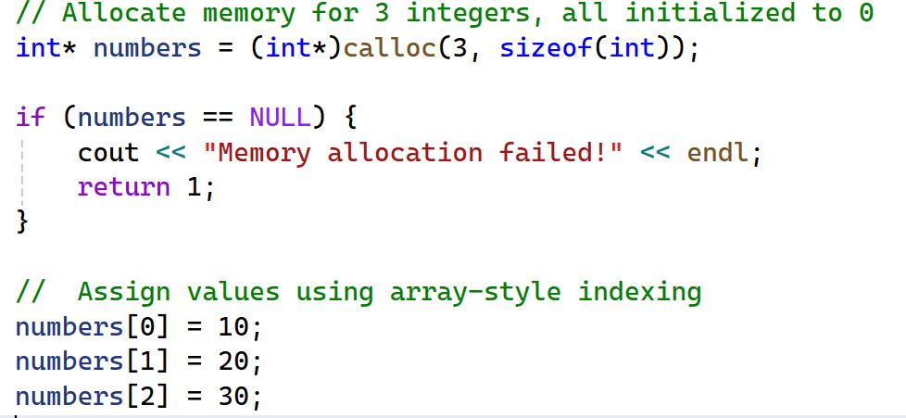
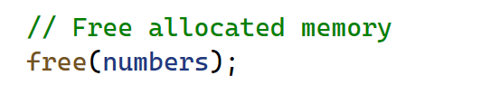
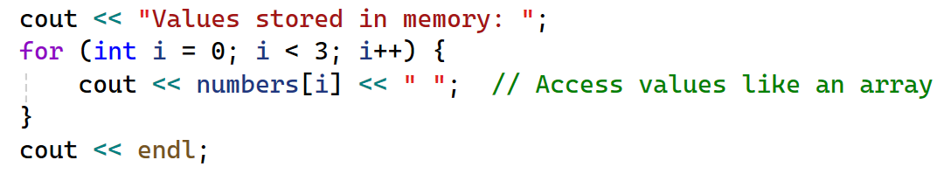
calloc()

Slide 6
List
A list is a collection of elements arranged in a specific order, where each element has a position (index)
1
2
3
4
index
0
20 | 76 | 22 | 33 | 60
Cursor: A cursor is like a pointer that shows where you are in the list

Slide 7
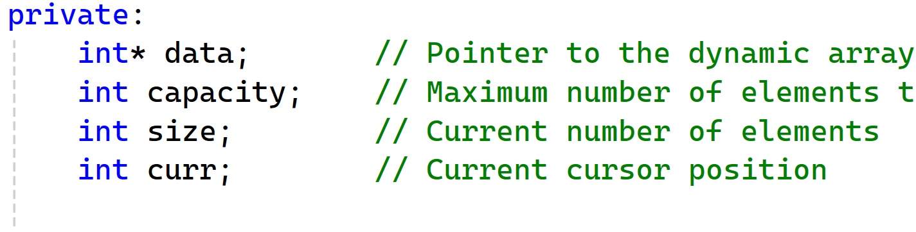
List

Slide 8
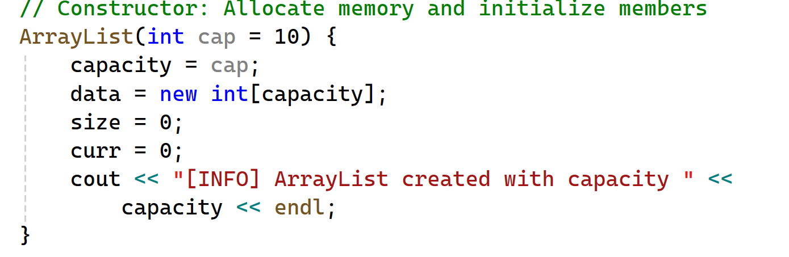
List

Slide 9
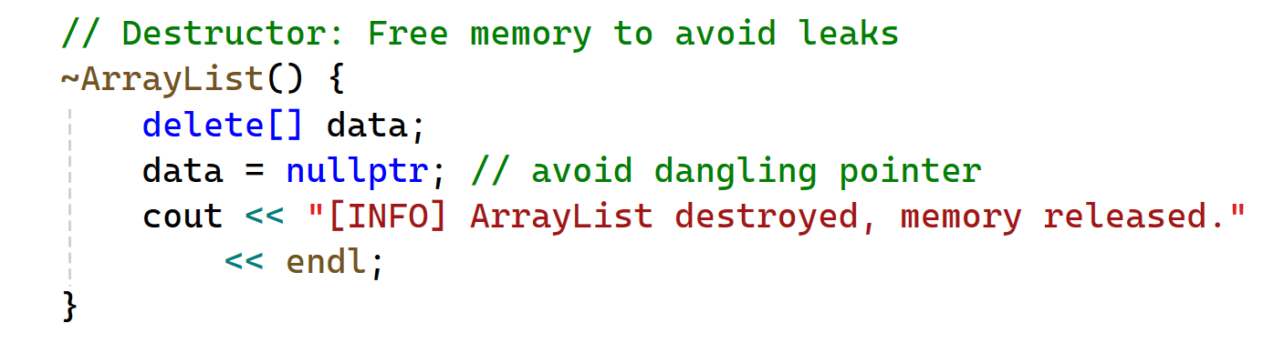
List

Slide 10
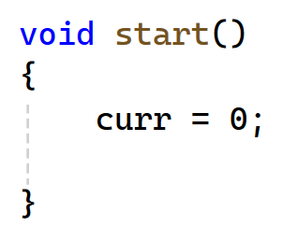
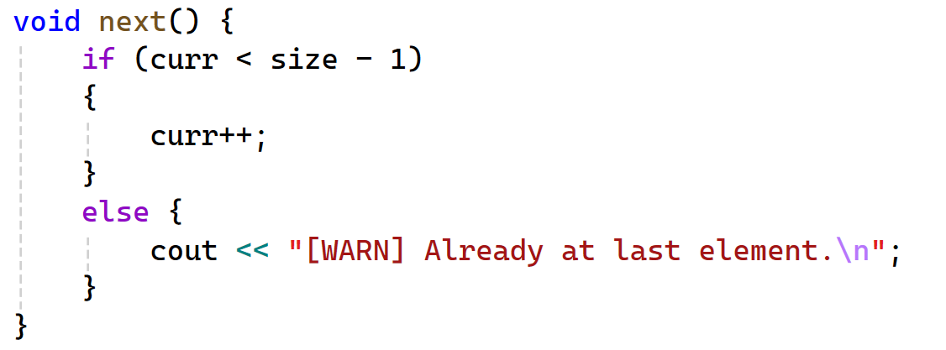
List
1
2
3
4
index
0
20 | 76 | 22 | 33
int cursor= 0;

Slide 11
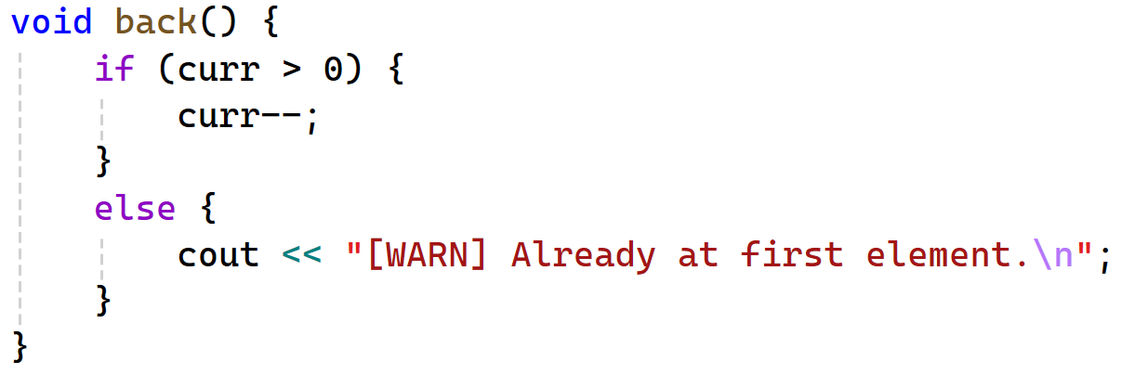
List
1
2
3
4
index
0
20 | 76 | 22 | 33
int cursor= 0;

Slide 12
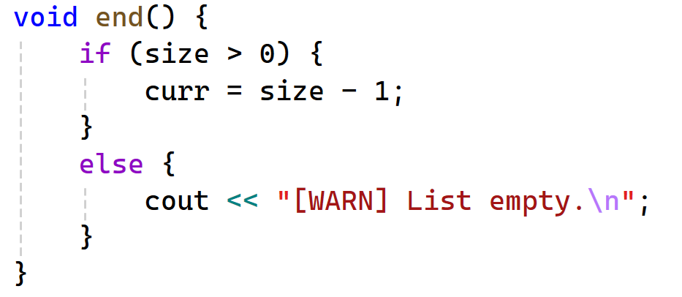
List: insertion
1
2
3
4
index
0
20 | 76 | 22 | 33
int cursor= 0;

Slide 13
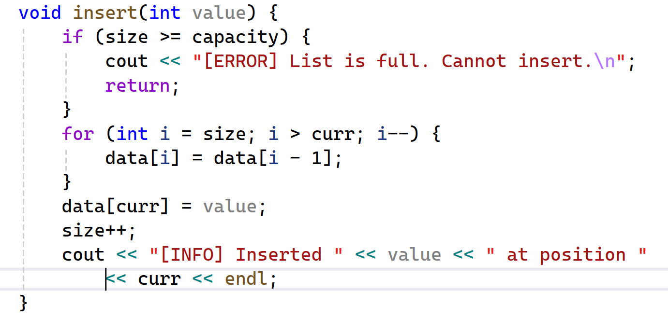
List: insertion
1
2
3
4
index
0
20 | 76 | 22 | 33
int cursor= 0;

Slide 14
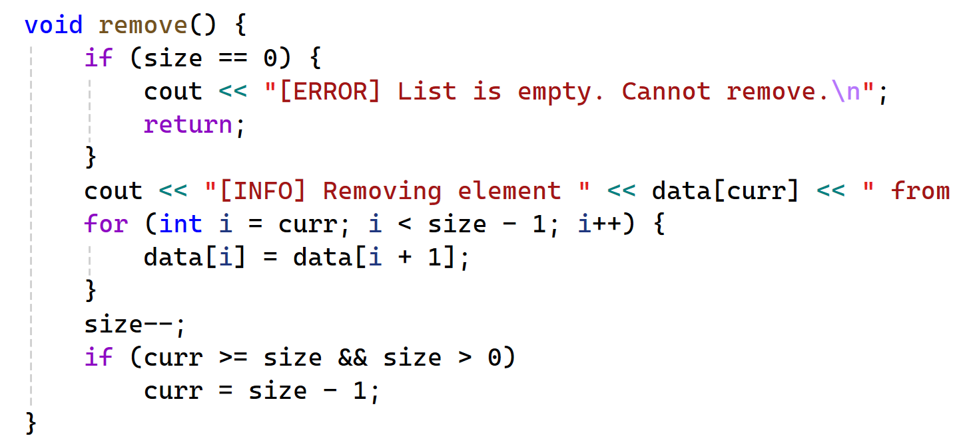
List: remove
1
2
3
4
index
0
20 | 76 | 22 | 33
int cursor= 0;

Slide 15

THANK YOU!

